Slide 1
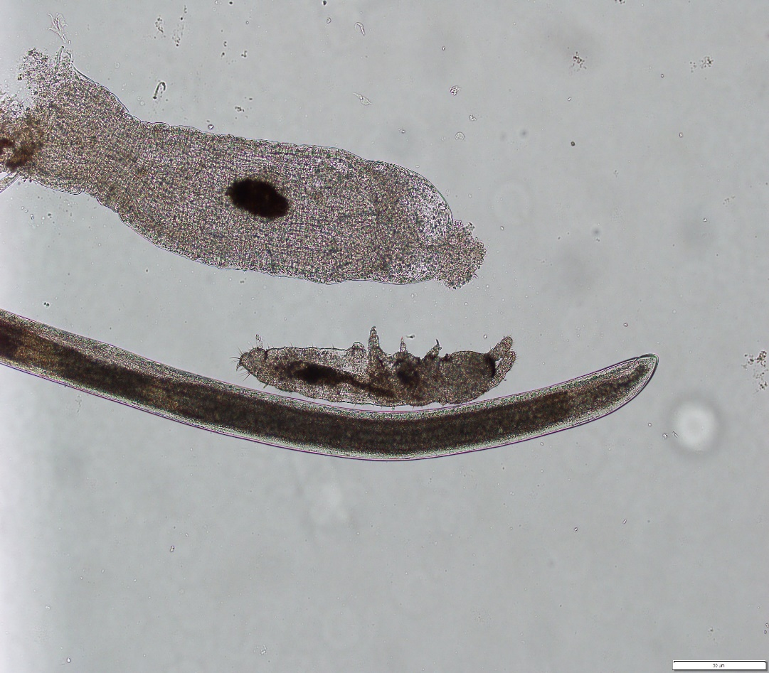
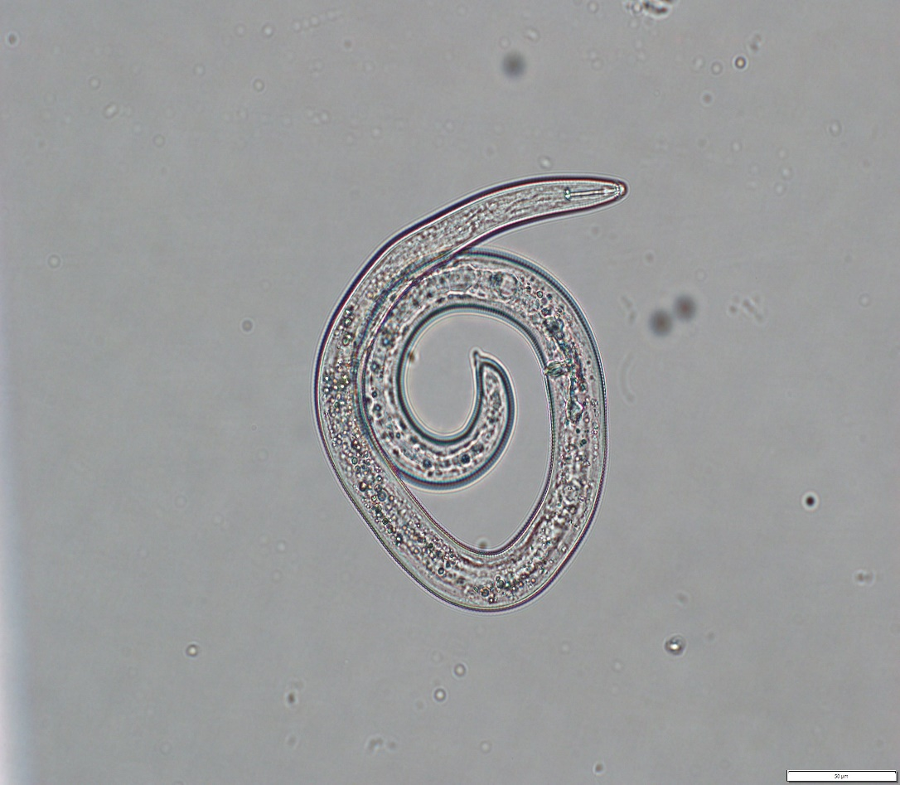
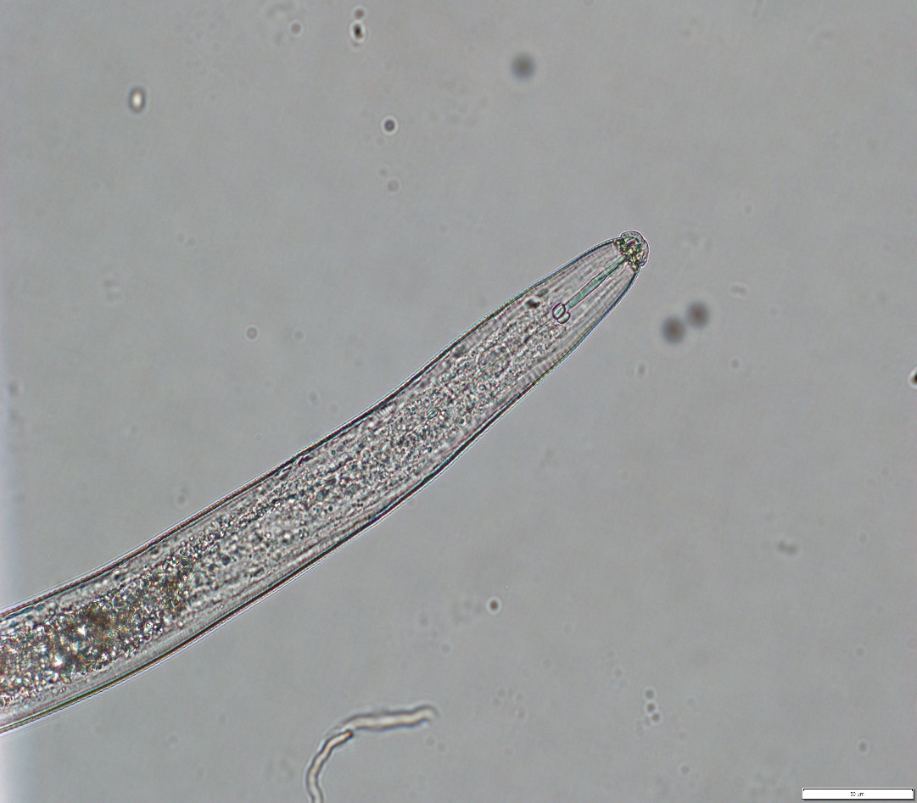
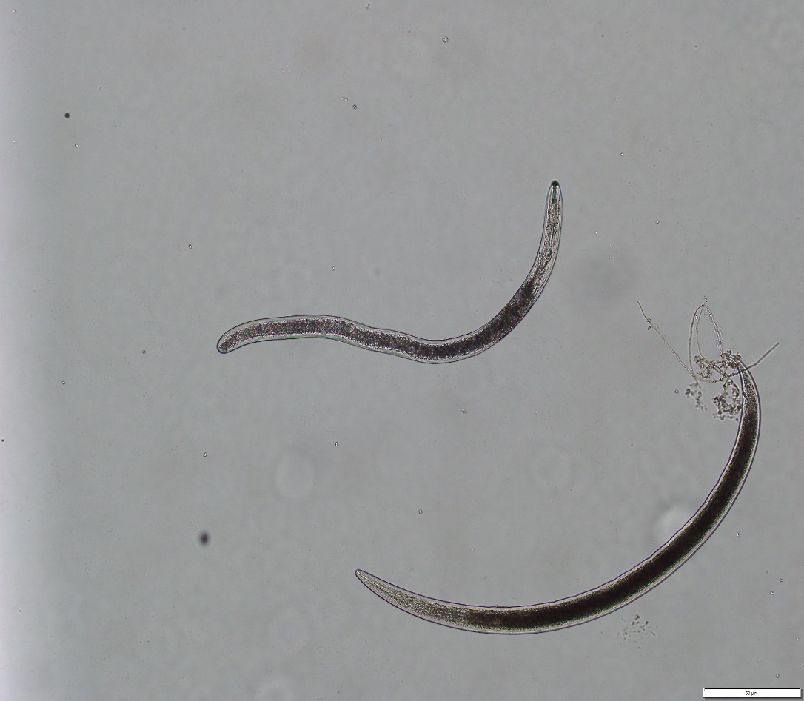
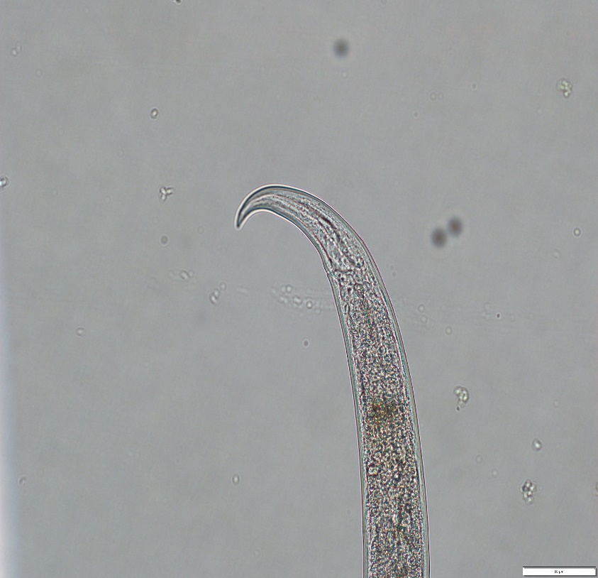
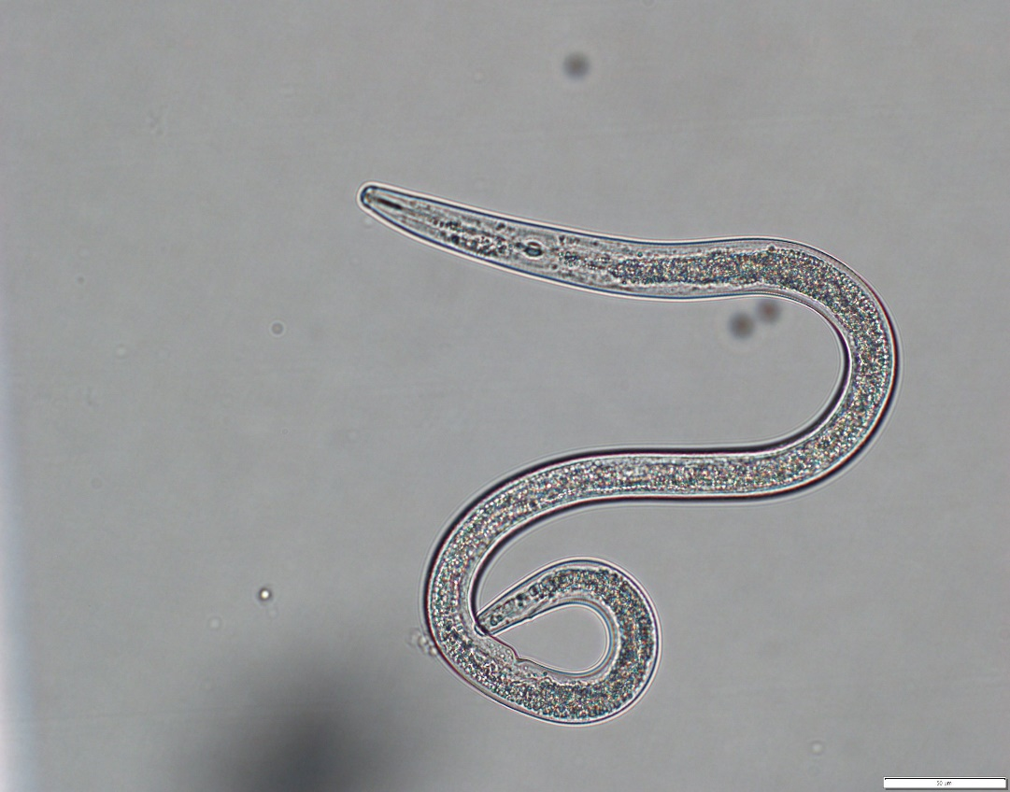
A Comparison of Soil Microorganisms in an Organic vs Conventional Plot
By Peighton Foster with help from James Kotcon and Holly Perkins
West Virginia University Organic Farm Internship
Abstract
Results
Conclusion
This research project was conducted in order to compare the soil diversity and internal components of organic soil versus soil that was treated conventionally (with pesticide use). The soil gathered from each site was then looked at under a microscope in order to gain insight into what comprised the soil, whether it be nematodes, plastic particles, plant parasites mites, etc. This study began with a hypothesis that there would be more soil diversity as it pertained to microorganisms in the organic soil compared to the conventional soil as the use of chemicals would kill any living organisms residing at the plot. More specifically, there would be a higher amount of nematodes in the organic soil with a larger variety of species as well.
Materials
By counting the amount of nematodes, it was found that the highest amount of nematodes were found in the conventional plot with a count of 3520 nematodes per 100 cc’s of soil while the organic plot had only 1720 nematodes per 100 cc’s of soil. Species noted from each plot were found to be the spiral nematode (Helicotylenchus) at the Organic Farm, and the lance nematode (Hoplolaimus) at the Livestock Farm. Both of these nematodes are plant parasites, however predatory species of nematodes (Mononchus) were found at low levels. Other organisms found worth mentioning are the collembola and mycorrhiza found in conventional soil and the oligochaete found in the organic soil.
By conducting this study, the original hypothesis of the organic soil containing more diversity and number of species was proven to be incorrect. The highest number of species was found to be at the conventional plot at the Livestock Farm near the orchard. Reasons for this could be increased animal activity, user error, higher water content due to soil erosion, or tillage differences (higher amount of tillage compared to Organic Farm). However, the lance nematode dominated the plant parasitic community at the Livestock Farm and is perhaps the most damaging. This could also be used to assess the health of the soil as lance nematodes were not found as commonly in the Organic Farm.
Soil sampler
Plastic bags
Use of a laboratory with all of the following:
Centrifuge
Microscope
Sucrose solution (60%)
Sieve
20 um sieve
Glass vials
100 cc beakers
Introduction
Methodology
Nematodes are among the most abundant living creatures on the planet. They are roundworms that are commonly found in soil, but have even been found in the Earth’s crust and the Arctic. Most are microscopic, but some species can be as long as 23 feet long (a parasite found in whales). Nematodes can act as parasites in animals, most known as hookworms, pinworms, and lungworms. These worms are usually tapered at both ends and are non-segmented with an alimentary canal (digestive tract) that extends from the mouth to the anus. Nematodes have a reproductive tract but lack a respiratory or circulatory system. Most nematodes are found in course soil and marine environments as water films help the nematode to move around in their surroundings. Nematodes can be classified into bacterial-feeders, fungal-feeders, predators, and omnivores. Bacterial-feeding nematodes consume bacteria, fungal-feeders feed on fungi by puncturing the cell wall and feasting on internal contents, predators eat other nematodes as well as smaller species of microorganisms, and omnivores eat a variety of species.
To begin, soil samples were taken from 3 plots: the WVU Organic Farm, and 2 plots from the WVU Livestock Farm (orchard area). These soil samples were then taken to the lab and used to isolate nematodes. This was done by mixing the samples with water until completely homogenous. The liquid was then passed through a sieve to rid of any large debris and the remaining liquid was collected into small glass vials and put into a centrifuge for 3 minutes. The supernatant was removed, leaving the soil pellet at the bottom. This soil pellet was mixed with a 60% sucrose solution and centrifuged again. This was to allow the nematodes to float to the top of the vial. After centrifuging, the supernatant was passed through a 20 um sieve and rinsed into a labeled vial. This vial was left to rest for 20 minutes to allow nematodes and other organisms to sink to the bottom. This process was repeated for each plot. After the allotted 20 minutes, most of the liquid except for 1 inch at the bottom was vacuumed away, leaving only the organisms. This was poured into a viewing dish and looked at under a microscope.
Recommendations
For future repeats of this study, it is recommended that a higher amount of practice isolating nematodes is necessary in order to decrease time needed to conduct nematode isolation. More replication may also be needed in order to assess statistical findings.
Collembola next to Oligochaete
Spiral nematode (Helicotylenchus)
Lance nematode (Hoplolaimus)
Lance nematode juvenile
Acknowledgements
A special thanks to Holly Perkins for teaching the isolation process and to Professor James Kotcon for gifting the use of his laboratory and equipment as well as his expertise in nematology.
Mononchus (predator)
Aphelenchus (fungal-feeder)

