Slide 1
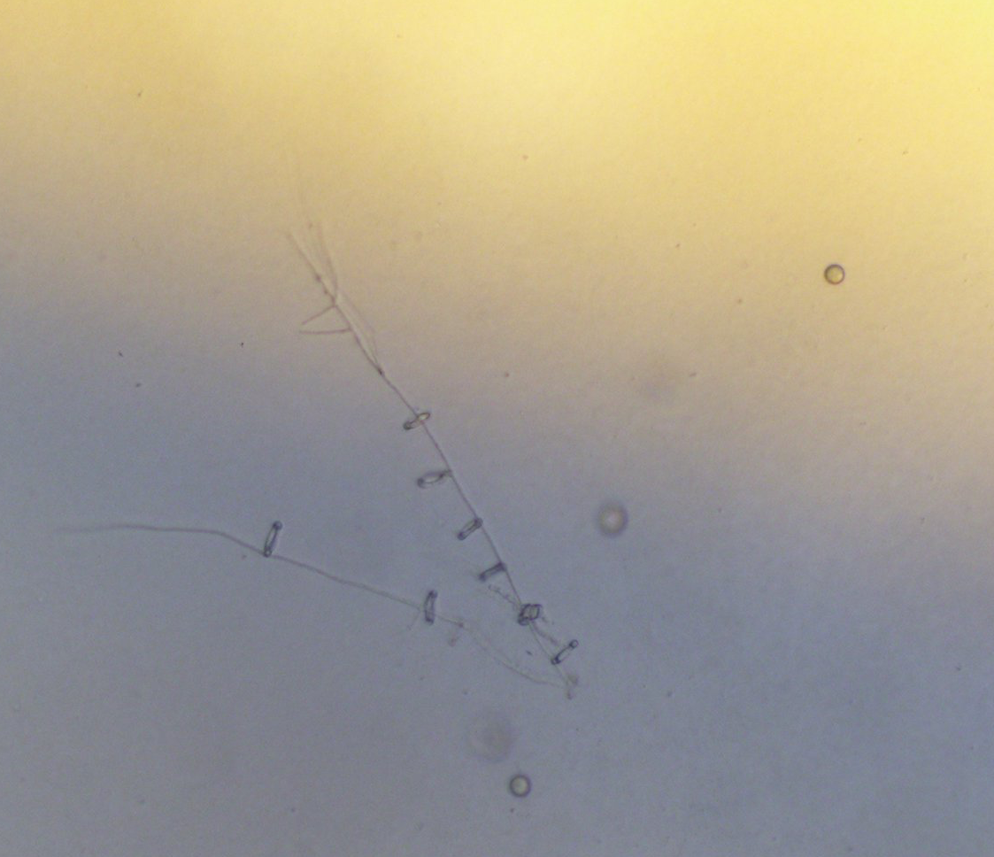
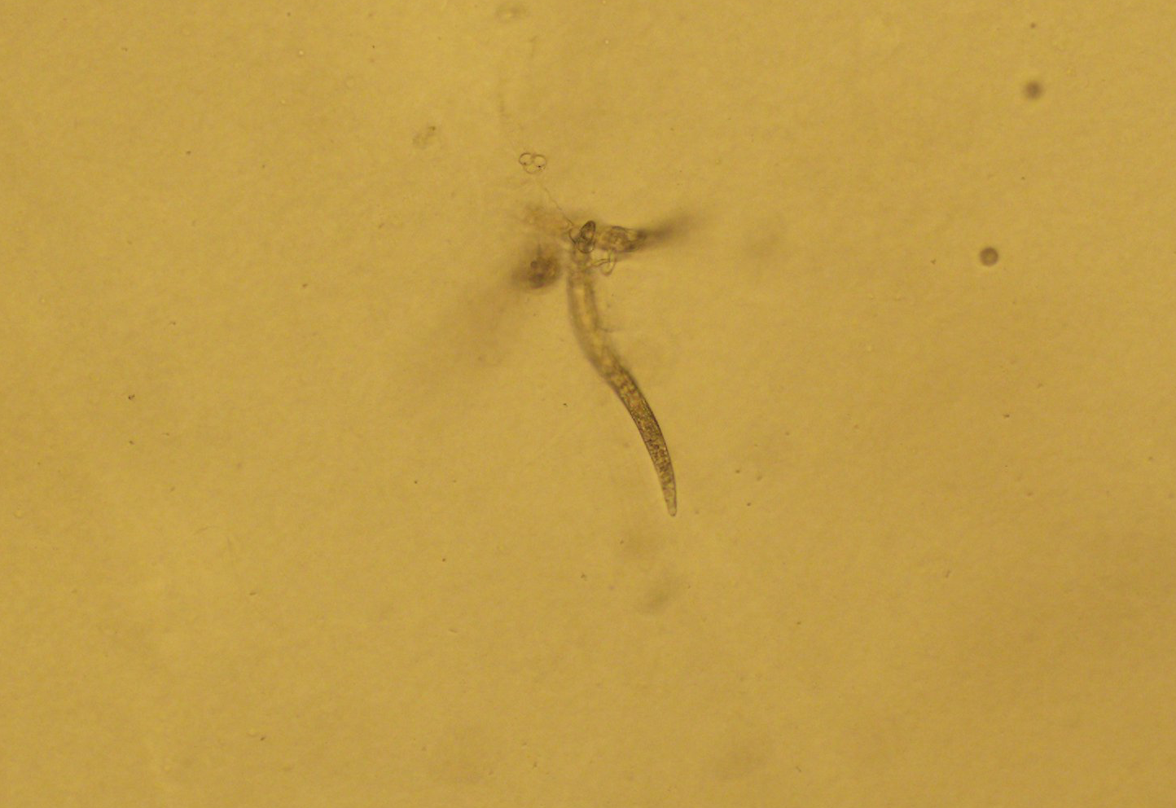
Nematode Enemies and Fungal Friends
Brandon Edgar and James Kotcon
Division of Plant and Soil Sciences, West Virginia University
Introduction
Nematodes, often called roundworms, are some of most abundant organisms on earth. Some nematodes are important parasites of plants, feeding on plant roots transmitting viruses, which cause disease to important crops. Nematode trapping fungi are soilborne fungi that act as a biological control agents. They capture nematodes by using specialized structures such as nets, ring traps or sticky structures.
Nematodes
Why It Matters
Nematodes include both beneficial and pest species. I focus on plant pest nematodes. These include species such as root knot nematode (Meloidogyne hapla), dagger nematode (Xiphinema americanum), and many more.
Controlling nematode pests is important to reduce yield losses and economic losses from damaged crops. While some nematodes can be controlled through common practices such as crop rotations, these are not applicable when it comes to orchards. Natural predators of nematodes (trapping fungi) could prove beneficial by keeping population densities below the damage threshold.
Nematode Trapping Fungi
These fungi are cosmopolitan microorganisms able to modify their behavior from saprophytic to carnivorous, allowing them to feed on nematodes under unfavorable nutritional conditions through various specialized structures. They can have adhesive networks ( Fig. 1 and 2), non-constricting and constricting rings (Fig. 3 and Fig. 4), and adhesive knob traps. Efficacy and trap formation vary based on species.
Figure 1. Arthrobotrys oligospora spores and net trap.
Control Methods
Figure 3. Dactylaria ring traps along hyphae.
Management practices aim at keeping nematode population densities below damage thresholds. Some species of nematodes are better understood than others when it comes to control efficacy. Dagger nematodes are an example of an important plant pest that is understudied. Control practices include soil fumigation, nematicides, and crop rotations. However, dagger nematodes are a serious pest of peach trees, and these control practices are more limited in orchards. This makes practices such as biocontrol more important to understand for control efficacy.
Figure 2. Root knot nematode trapped in Arthrobotrys oligospora net trap.
Figure 4. Nematode caught in ring trap.
Increasing Trap Activity
Certain variables have been noted to increase trap activity such as the presence of urea, nematode pheromones, and management practices that increase microbial activity (such as compost). However, trapping fungi also are not fully understood. A lot of research focuses on fungi grown on agar, but this does not directly correlate to control efficacy in the soil. Data from the WVU Organic Farm’s Organic Crop-Livestock Farming Systems experiment showed that field plots managed with a low input (no compost) system produced greater populations of trapping fungi than high input (with compost) systems, contrary to previous studies (Fig. 5).
Figure 5. Nematode trapping fungi and biocontrol activity in soils from long-term farming system plots managed with high (with compost) and low input (no compost).
Acknowledgements
Financial support was provided by USDA-NIFA (Award Number: 2018-51106-28777), and the WVU Agriculture and Forestry Experiment Station

